Slide 1
Alvin Webb, Jr. Student Success Coach Student Success Initiatives
TEAS MATH
TEST PREP

Slide 2
Starting the exam
Gathering knowledge of the truth is the best preparation for tests.
Hours of concentrated, effective study help to carefully place facts into your memory. This is the best way to prepare for any test.
However, teachers often try to test your memory of the material by slightly altering it. In this case, practice and some test-taking skill will help.
Always arrive early and take a moment to relax and reduce anxiety.
This brief time period will boost your confidence.
Use this time to focus your mind and think positive thoughts.
Listen attentively to last minute instructions given by the instructor.
Teachers often make last minute changes.
Missing instructions can cause extreme anxiety.

Slide 3
Starting the exam
Read the test directions very carefully and watch for details.
You may find that one answer may be possible on multiple choice tests.
A key detail may require that you choose only three out of the five essay questions.
Plan how you will use the allotted time.
Estimate how many minutes you will need to finish each test section.
Determine a pace which will ensure completing the whole test on time.
Start with the easiest sections to build your confidence.
Maintain a positive attitude.
Don’t let more difficult questions raise your anxiety and steal your valuable time. Move on and find success with other questions.
Avoid watching for patterns. Noticing that the last four answers are “c,” is not a good reason to continue with that pattern.

Slide 4
Starting the exam
Rely on your first impression.
The answer which comes to mind first is often correct.
Nervously reviewing questions and changing answers can do more harm than good.
Plan to finish early and have time for review.
Return to difficult questions you marked for review.
Proofread your essays and pay attention to grammar and spelling.
Make sure you answer all the questions. Many students have failed to notice questions on the back side of the paper.
Consider every test a practice session – analyze your performance.
Test taking is an art which needs refinement. One can not refine the art without practice and serious evaluation.
Go through each test thoroughly and see if your plan worked.
Look at each section to identify your fault patterns. Do you need to work on true/false, multiple choice, or essay questions?
Talk to teachers regarding low scores, especially on essays.

Slide 5
Guidelines for Answering True/False Questions
When you do not know the answer. Mark it true!
There are generally more true questions on true-false exams than false questions.
Instructors find it difficult to make a false statement look true.
Specific detail in the statement may also tend to make it true. For example, the statement “Babe Ruth hit 60 home runs in one season” has specific detail and is more likely to be true.
Look for any factor that will make a statement false.
It is easy for the instructor to add a false part to an otherwise true statement.
Students often read the question and see some truth and quickly assume that the entire statement is true. For example, “Water boils at 212 degrees in Denver.” Water boils at 212 degrees, but not at Denver’s altitude.

Slide 6
Guidelines for Answering True/False Questions
Look for extreme modifiers that tend to mark the question false.
Extreme modifiers, such as always, all, never, or only make it more likely that the question is false.
Here is a more complete list of EXTREME modifiers.
all
best
none
absolutely
always
never
worst
absolutely not
only
nobody
everybody
certainly
invariably
no one
everyone
certainly not

Slide 7
Guidelines for Answering True/False Questions
Qualifying words tend to make a question true.
Qualifiers (seldom, often, many) increase the likelihood that the statement is true.
Here is a more complete list of QUALIFIERS.
usually
some
probably
might
sometimes
unlikely
frequently
seldom
a majority
a few
much
often
many
apt to
may
most

Slide 8
Guidelines for Answering True/False Questions
Negative words or prefixes complicate the statement.
The prefixes (un-, im-, miss-) will alter the meaning of the statement.
Double negative make a positive. For example “not uncommon” actually means common.
Questions that state a reason tend to be false.
Words in the statement that cause justification or reason (since, because, when, if) tend to make the statement false.
Pay close attention, the reason that is given may be incorrect or incomplete.
There is no substitute for the truth.
Concentrated hours of study is the best way to prepare true-false questions.
Teachers, however, often try to test your memory of the material by slightly altering it.

Slide 9
Guidelines for Answering Multiple-choice Questions
Formulate your own answer before reading the options.
Focus on finding an answer without the help of the alternatives.
This process will increase your concentration.
Doing this will help you exercise your memory.
Eliminate unlikely answers first.
Quickly eliminating two alternatives may increase your probability to 50/50 or better.
Use the true-false methods described earlier and find the false alternative.
Select numbered answers from the middle range, not the extremes.
For example, if the height of a mountain is requested, eliminate 20,000 feet (high), and 3,000 feet (low). Then choose between 8,000 feet and 11,000 feet.

Slide 10
Guidelines for Answering Multiple-choice Questions
Select answers that are longer and more descriptive.
Longer (true) answers stand out and contain more detail.
Shorter (false) answers are created quickly as throwaways.
Descriptive detail is given to help you identify the truth.
Similar answers give you a clue! One of them is correct, the other is disguised.
Watch out for “NOT TRUE.”
Remember to reverse your procedure and eliminate truth.
Use the true-false methods described earlier and find the false alternative.

Slide 11
Guidelines for Answering Matching Questions
Examine both lists to determine the types of items and their relationships.
Remember the test maker may be testing to see if you have mastered terms.
Look completely through both lists to become familiar with the words, build your confidence and enhance your memory of key words or phrases.
Use one list as a starting point and go through the second list to find a match.
This process organizes your thinking and promotes memory.
As you become familiar with the second list, you will be able to go straight to a match that you saw when looking through the lists a previous time.

Slide 12
Guidelines for Answering Fill-in-the-blank Questions
Concentrate on the number of blanks in the sentence and the length of the space.
The test maker is giving you clues to the answer by adding spaces and making them longer.
Provide a descriptive answer when you can not think of the exact word or words.
The instructor will often reward your effort with partial credit.

Slide 13
Guidelines for Essay Questions
Organize your thoughts before you begin to write.
A short outline on a separate piece of paper will improve your essay.
Write the topics and the key introductory words.
Paraphrase the original question to form your introductory statement.
This process helps you get the question straight in your mind.
Restating the question allows the teacher to see how you understood the question. Perhaps you understood it to mean something other than what the teacher intended.
Use the principles of English composition.
Form a clear thesis statement (statement of purpose) and place it as near to the beginning as possible.
Provide clear explanations to back up the main concept.
Remember, a complete answer usually has a main idea, supporting details and illustrative examples.

Slide 14
Guidelines for Essay Questions
Write clearly! Teachers need to be able to read it.
Making teachers work hard to read lowers your grade.
Print clearly, using a dark-colored erasable ball point pen.
Avoid crossing out words or sentences, and don’t smudge your paper.
Remember to save some space for a brief but adequate summary.
Use lists or bullets wherever possible.
Numbers or bullets allow the teacher to easily see your points.
Never bury your lists or key points in the middle of a paragraph.
If you must use a long paragraph, underline your key points.
Identify the verbs or words in the question that give you direction.
Key words in each question describe the task you are expected to complete.
Circle the direction words in the question to make sure that you are focusing on the desired task.

Slide 15
ATI TEAS: The actual exam
Subject: Math
# Questions: 36
% of test questions: 22%
Time given: 54 minutes
Each question: About 1 minute 30 seconds
23 questions Number and Algebra, 9 questions Measurement and Data, 4 Pretest Items

Slide 16
ATI TEAS: The actual exam

Slide 17
Number and Algebra
1. How do you write the fraction $40\frac{31}{10,000}$ as a decimal?
2. How do you write the decimal number 0.016 as a fraction?
3. What is the decimal value of 3.5%?
4. Find the quotient: $\frac{7}{36}÷\frac{28}{45}.$
5. What is the correct answer to this expression: 4$+ \left(18÷3\right)×2= ?$

Slide 18
Number and Algebra
6. Find the sum: $\frac{3}{8}+\frac{3}{4}$ .
7. Which of the numbers in the following series has the greatest value: -7, 0, -2.1, -0.8?
8. Solve the following equation 5$x=65$ for $x.$
9. Solve the equation $y−45=0$ for $y.$
10. Solve the equation $\frac{3}{4}n+7=34$ for $n.$

Slide 19
Number and Algebra
11. Greg had $105 in his savings account. After depositing two identical weekly paychecks, he had $563 in the account. How much money does Greg earn each week?
12. Julio’s rock garden measures 8 feet by 4 feet. Julio wants to create a continuous border around the rock garden using square concrete paving blocks that measure 6 inches on a side. How many paving blocks should Julio purchase?

Slide 20
Number and Algebra
13. Last year, 128 babies were born on the fifth floor of the hospital. This year, 160 babies were born on the fifth floor. What was the percentage increase in babies born of the fifth floor?
14. At the electronics store sale, Jasmine purchased a computer tablet that was marked down 23% to $346.50. What was the original price of the tablet?

Slide 21
Number and Algebra
15. What is 2,346 rounded to the nearest 100?
16. What is 19.796 rounded to the nearest hundredth?
17. A 4324-lb truck needs to carry a load across a bridge with a legal limit of 6,400 lbs. What would be the largest load that the truck could legally carry on the bridge?

Slide 22
Number and Algebra
18. A nurse adds 4 g of salt to 20 ml of water to make a saline solution. How much salt should be added to 75 ml of water to make a solution of the same strength?
19. Tamara reads 40 pages of a novel in 52 minutes. How long will it take her to read a novel of 200 pages?
20. Renay rode her bike 3.2 miles in 12 minutes. At this rate, how long will it take her to ride the entire 42-mile trip from her house to Santa Fe?

Slide 23
Number and Algebra
21. The coordinates for point A are (4,4). The coordinates for point B are (1,2). Find the slope.
22. Sergio had twelve fewer credits than five times what Joanna had. What expression describes the number of Sergio’s credits?
23. Ninety-two added to five times Herbert’s weekly salary is less than Mrs. Morton’s weekly salary of $1,119. What mathematical expression describes this situation?

Slide 24
Measurement and Data

Slide 25
Measurement and Data
1. On the graph from the previous PowerPoint, what percentage of the time do nurses spend on prep work and paperwork?
2. One nursing textbook states that nurses in a good-quality facility will spend 60% of their time in patient care, but in the best facilities, nurses devoted 70% of their time to patient care. What can you conclude about Sound Shore Hospital from the graph on the previous PowerPoint?

Slide 26
Measurement and Data
The table below shows Hector’s scores from seven different judges in a gymnastics competition. Use this table to answer the next two questions.
Judge | 1 | 2 | 3 | 4 | 5 | 6 | 7
Score | 8.6 | 7.8 | 8.6 | 8.2 | 9.5 | 8.6 | 9.6

Slide 27
Measurement and Data
3. What was greater, Hector’s median score or mode score? By how much?
4. Which score change would push the mean value of Hector’s scores to 9.0 or above?

Slide 28
Measurement and Data
5. Which of the following pairs of variables has a negative covariance?
(A) x = number of snowballs in one winter, y = number of snow shovels sold
(B) x = number of hours Reza works in a month, y = amount of Reza’s paycheck
(C) x = time spent running on a treadmill, y = number of calories burned
(D) = number of customers renting a room in a motel, y = number of rooms available

Slide 29
Measurement and Data

Slide 30
Measurement and Data
6. What is the total perimeter measurement of the free throw lane?
7. What is the total area of the free throw lane in the diagram on the previous PowerPoint?

Slide 31
Measurement and Data
8.

Slide 32
Measurement and Data
9. A nurse poured 3.2 quarts of liquid into a container. How many fluid ounces were in the container?
10. 45.6 cm equals how many hectometers?
11. Each day, a 125-lb patient is supposed to receive 0.8 mg of medication per kilogram of body weight. What dosage should the patient receive?

Slide 33
Number and Algebra Answers
40.0031
$\frac{16}{1,000}$
0.035
$\frac{5}{16}$
16
$\frac{9}{8}$
7. 0
8. 13
9. 45
10. 36
11. $229
12. 48
13. 25%
14. $450
15. 2,300
16. 19.80
17. 2,050 lbs
18. 15 g
19. 4 hours, 20 minutes
20. 157.5 min
21. $\frac{2}{3}$
22. 5x-12
23. 5s + 92 < 1119

Slide 34
Measurement and Data Answers
17.5%
The hospital is rated good but not the best.
The mode and median were both the same, 8.6.
Judge 2 increasing his score by 2.1.
(D)
68.84 ft
7. 284.52 ft²
8. 588 cm²
9. 102.4 fl oz
10. 0.00456 hm
11. 45.36 mg

Slide 35
TEAS Math: What to Expect
Decimal Conversion to Fraction
Fraction to Decimal
Order of Operations
One Variable Equations
Statistical Evaluation of Data
Geometry
Story Problems
English to Metric Conversions
Standard and Metric Systems Conversions
Metric Prefix Equivalents
Metric Abbreviations & Prefixes
Length, weight and fluid abbreviations

Slide 36
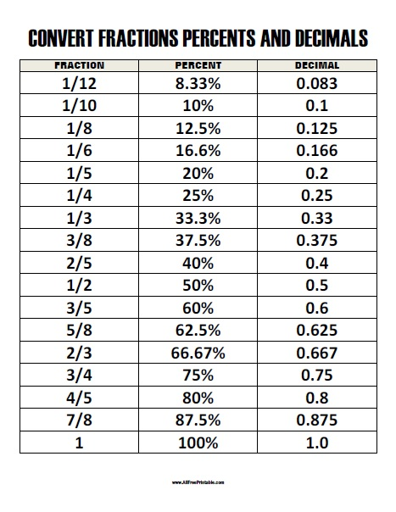
TEAS MATH: What Do You Need to Know
Place Value
Fractions Decimals Percents

Slide 37
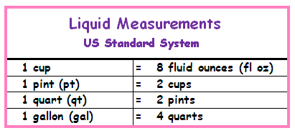
TEAS MATH: What Do You Need to Know
Standard and Metric Systems

Slide 38
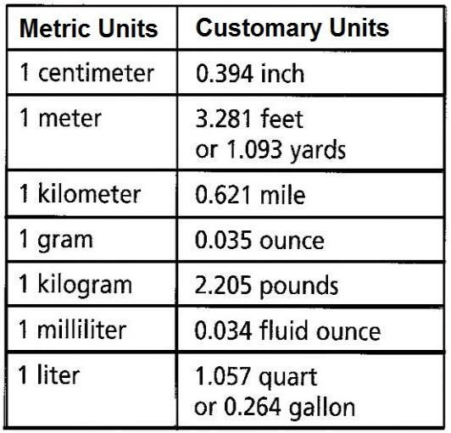
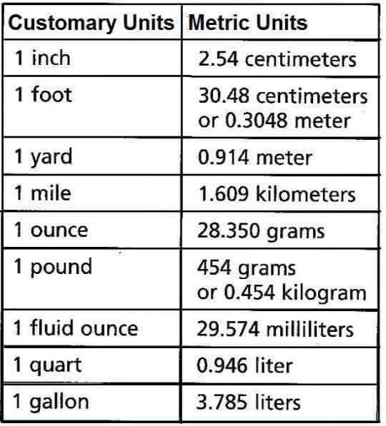
TEAS MATH: What Do You Need to Know
English to Metric Conversions

Slide 39
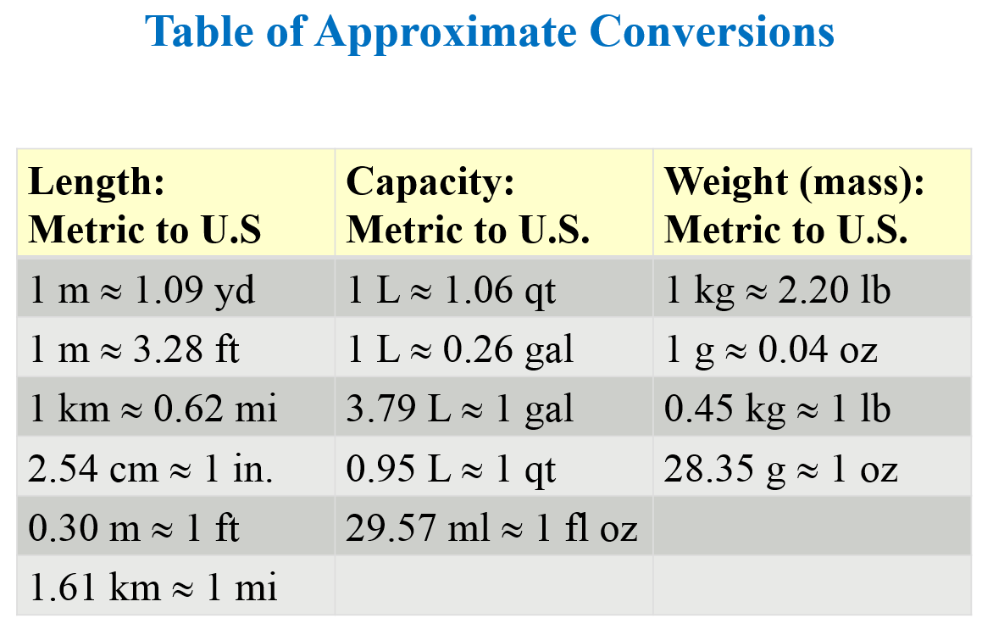
TEAS MATH: What Do You Need to Know
Metric/Standard Conversions
Length | Volume
1 m = 39.37 in | 1 liter = 33.81 fl oz

Slide 40
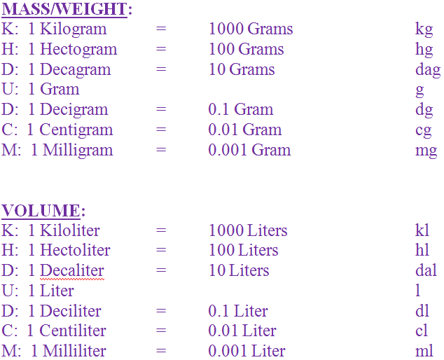
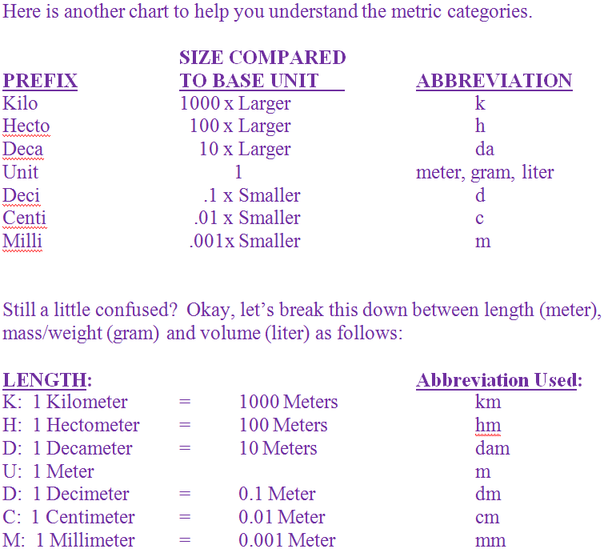
TEAS MATH: What Do You Need to Know
Metric System of Measurement

Slide 41
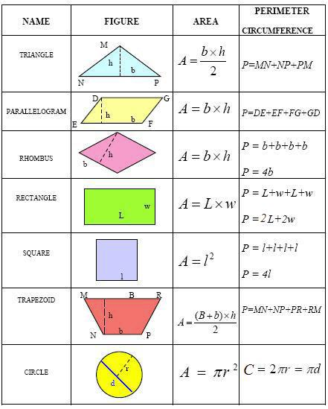
TEAS MATH: What Do You Need to Know
Geometry Formulas
Please go to the following website for more geometric formulas.
https://www.effortlessmath.com/math-topics/ati-teas-6-math-formulas/

Slide 42
Additional Resources
Please visit the following websites for more TEAS test prep in mathematics and other subject areas.
https://www.youtube.com/watch?v=PwTOlF9ez5I
https://library.ivytech.edu/testprep/TEAS
https://www.test-guide.com/teas-study-guide.html
https://www.bcraftmath.com/atiteas.html

Slide 43
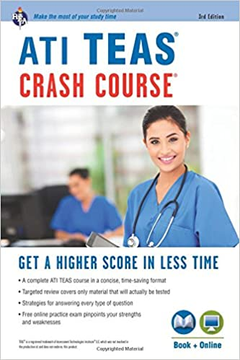
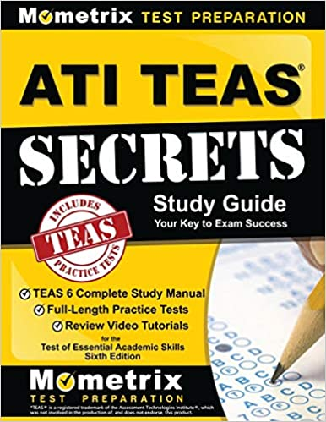
Additional Resources
Available on Amazon,
Barnes & Noble,
Thriftbooks.com and
other websites.

Slide 44
ATI TEAS Overview, facts and study tips

Slide 45
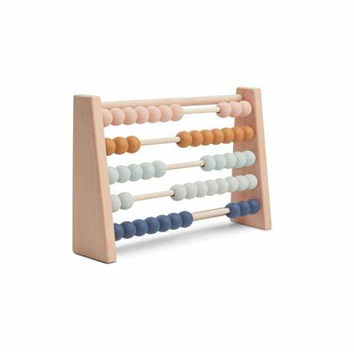
Hope you do well. Cheers!
Thank You!

